Slide 1
Sequential digital circuit

Slide 2
Lecture 37 Registers and counters
Lecture delivered by:
Deepak V.

Slide 3
Objectives
At the end of this lecture, student will be able to:
Acquire the knowledge of shift registers and counters
Define shift register and counters
Design shift registers and counters
Realize counters and shift registers using flip flops

Slide 4
Topics
Introduction to shift registers
Realization of shift registers
Introduction to counters
Realization of different types of counters

Slide 5
Shift registers
A register is a group of flip‐flops, each one of which shares a
common clock and is capable of storing one bit of information
A register capable of shifting the binary information held in
each cell to its neighboring cell, in a selected direction, is
called a shift register
The logical configuration of a shift register consists of a chain
of flip‐flops in cascade, with the output of one flip‐flop
connected to the input of the next flip‐flop

Slide 6
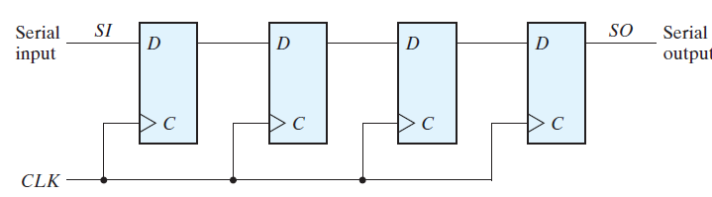
Shift registers
The simplest possible shift register is one that uses only
flip‐flops, as shown in figure
Four‐bit shift register

Slide 7
Shift registers
Each clock pulse shifts the contents of the register one bit
position to the right
The serial input determines what goes into the leftmost
flip-flop during the shift
The serial output is taken from the output of the rightmost
flip-flop

Slide 8
Universal Shift registers
Universal shift register has:
A clear control to clear the register to 0
A clock input to synchronize the operations
A shift-right control to enable the shift operation and the
serial input and output lines associated with the shift right
A shift-left control to enable the shift operation and the
serial input and output lines associated with the shift left

Slide 9
Universal Shift registers
Universal shift register has:
A parallel-load control to enable a parallel transfer and the n
input lines associated with the parallel transfer
n parallel output lines
A control state that leaves the information in the register
unchanged in the presence of the clock
If the register has both shifts and parallel load capabilities, it
is referred to as a universal shift register

Slide 10
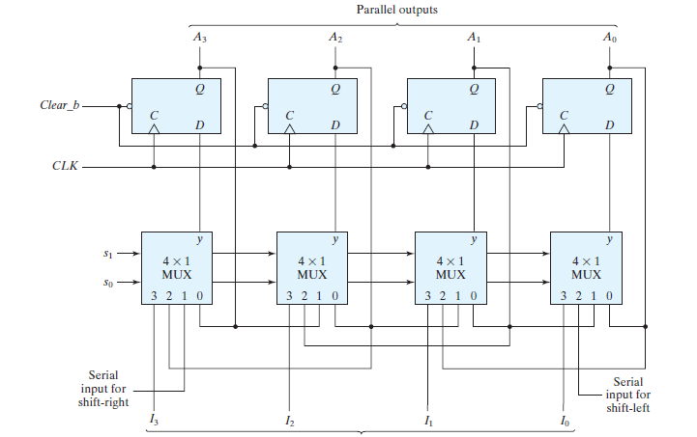
Universal Shift registers
Four‐bit universal shift register

Slide 11
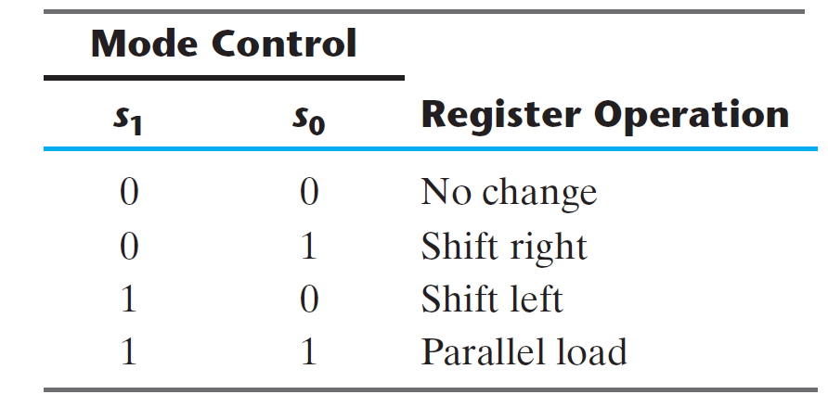
Universal Shift registers
Function Table for the Register

Slide 12
Universal Shift registers
Shift registers are often used to interface digital system
situated remotely from each other
If the distance is far, it will be expensive to use n lines to
transmit the n bits in parallel.
Transmitter performs a parallel-to-serial conversion of data
and the receiver does a serial-to-parallel conversion

Slide 13
Ripple Counters
A register that goes through a prescribed sequence of
states upon the application of input pulse is called a
counter
A counter that follows the binary number sequence is
called a binary counter
Counters are available in two categories
Ripple counters
Synchronous counters

Slide 14
Binary Ripple Counter
The output of each flip-flop is connected to the C input of the
next flip-flop in sequence
The flip-flop holding the last significant bit receives the
incoming count pulse
A complementing flip-flop can be obtained from:
JK flip-flop with the J and K inputs tied together.
T flip-flop
D flip-flop with the complement output connected to the D input

Slide 15
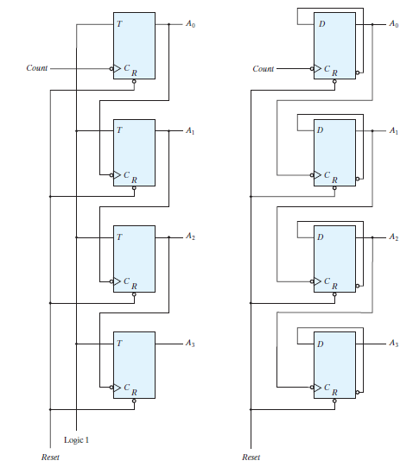
Binary Ripple Counter
Four‐bit binary ripple counter

Slide 16
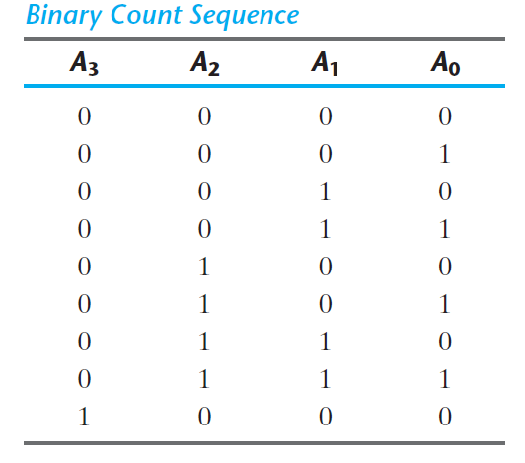
Binary Ripple Counter
Binary Count Sequence

Slide 17
BCD Ripple Counter
A decimal counter follows a sequence of ten states and
returns to 0 after the count of 9
This is similar to a binary counter, except that the state after
1001 is 0000
The operation of the counter can be explained by a list of
conditions for flip-flop transitions
The four outputs are designated by the letter symbol Q with a
numeric subscript equal to the binary weight of the
corresponding bit in the BCD code

Slide 18
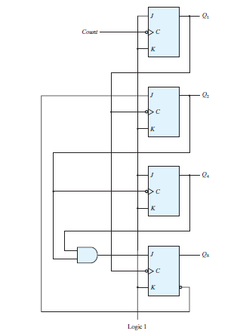
BCD Ripple Counter
BCD ripple counter

Slide 19
Synchronous Counters
Synchronous counters are different from ripple counters in
that clock pulses are applied to the inputs of all flip-flops
A common clock triggers all flip-flops simultaneously rather
than one at a time in succession as in a ripple counter
The design of a synchronous binary counter is so simple that
is no need to go through a sequential logic design process
Synchronous binary counters have a regular pattern and can
be constructed with complementing flip-flop and gates

Slide 20
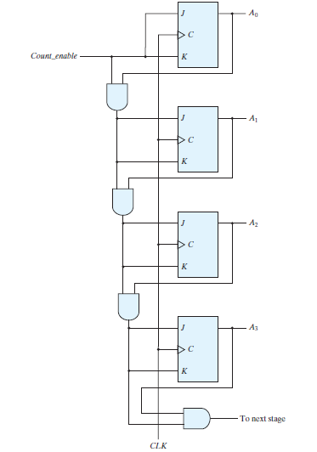
Synchronous Counters
Four‐bit synchronous binary counter

Slide 21
Up-Down Binary Counter
The two operations can be combined in one circuit to form a
counter capable of counting up or down
It has an up control input and down control input
Because of the return to 0 after a count of 9, a BCD counter
does not have a regular pattern as in a straight binary count
To derive the circuit of a BCD synchronous counter, it is
necessary to go through a sequential circuit design procedure

Slide 22
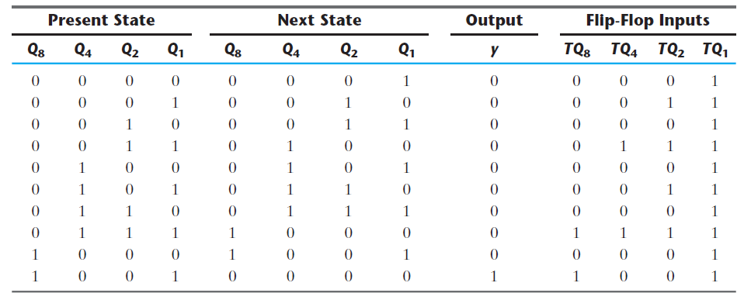
BCD Counter
State Table for BCD Counter

Slide 23
Binary Counter with Parallel Load
Counters employed in digital systems quite often require
a parallel load capability for transferring an initial binary
number into the counter prior to count operation
The input load control when equal to 1 disables the
count operation and causes a transfer of data from the
four data inputs into the four flip-flops

Slide 24
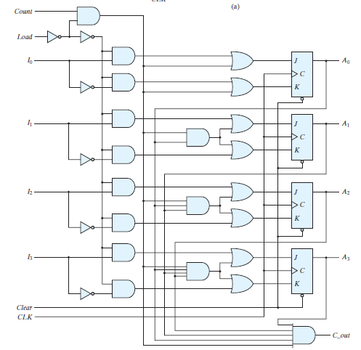
Binary Counter with Parallel Load
Four‐bit binary counter with parallel load

Slide 25
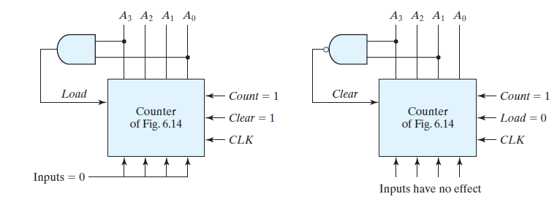
Binary Counter with Parallel Load
A counter with parallel load can be used to generate any
desire count sequence
Figure shows two ways in which a counter with parallel
load is used to generate the BCD count
Two ways to achieve a BCD counter using a counter with parallel load

Slide 26
Ring Counter
A ring counter is a circular shift register with only one flip-flop
being set at any particular time, all others are cleared
The single bit is shifted from one flip-flop to the next to produce
the sequence of timing signals. [Fig. (a)] [Fig. (c)]
The decoder shown in [Fig. (b)] decodes the four states of the
counter and generates the required sequence of timing signals

Slide 27
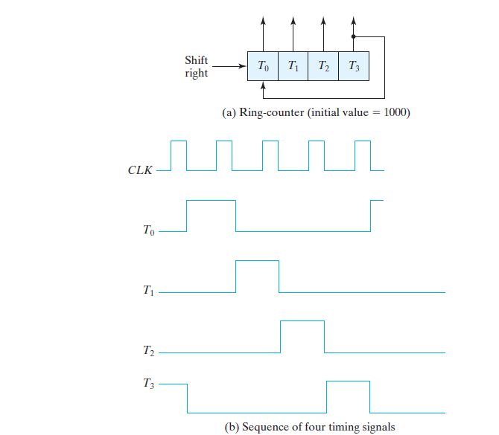
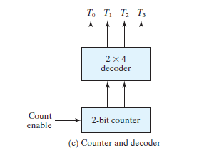
Ring Counter
Generation of timing signals

Slide 28
Johnson Counter
Generate the timing signals with a combination of a shift
register and a decoder, which is called a Johnson counter
The number of states can be double if the shift register is
connect as a switch-tail ring counter. [Fig. (a)]
Starting from a cleared state, the switch-tail ring counter
goes through a sequence of eight states, as shown in
[Fig.(b)]

Slide 29
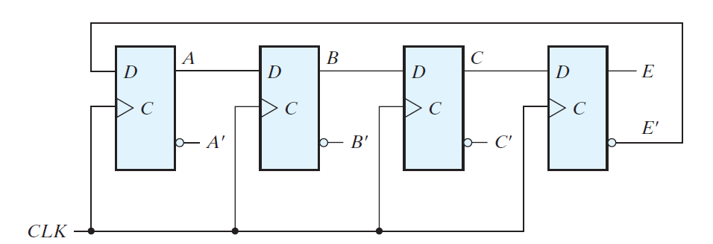
Johnson Counter
Four-stage switch-tail ring counter

Slide 30
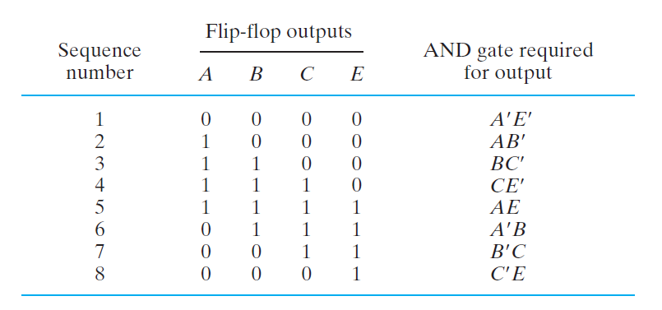
Johnson Counter
Count sequence and required decoding

Slide 31
Summary
A register capable of shifting the binary information held in
each cell to its neighboring cell, in a selected direction, is
called a shift register
A register that goes through a prescribed sequence of
states upon the application of input pulse is called a
counter
Synchronous binary counters have a regular pattern and can
be constructed with complementing flip-flop and gates

